Slide 1
Lunch & Learn Anchor & Concrete Reinforcement Design
Oct 6, 2022

Slide 2
Table of Contents
Anchors
Anchor failure modes
Anchor types & design
Anchor practical considerations
Anchor & bolt hole typical/min dimensions and distances
Typical anchor baseplate pier sizes
Concrete Reinforcement
Typical concrete rebar
Concrete rebar types
Code requirements & recommendations
Key notes on reinforcement requirements
Reinforcement details good practices

Slide 3
1. Anchors
Anchor failure modes
Anchor types & design
Anchor practical considerations
Anchor & bolt hole typical/min dimensions and distances
Typical anchor baseplate pier sizes

Slide 4
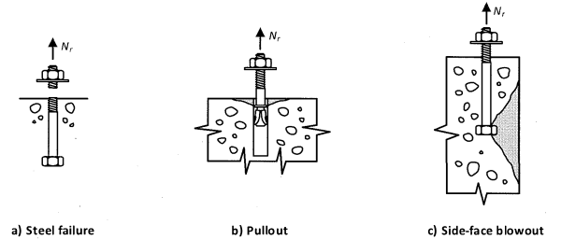
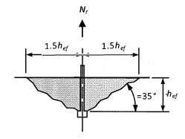
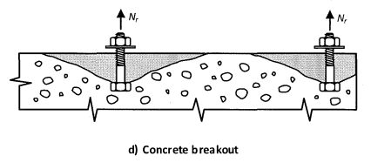
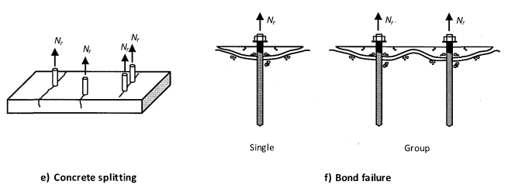
Anchor Tension Failure Modes, CSA A23.3-14
Mechanical and cast in place anchors
Adhesive anchors

Slide 5
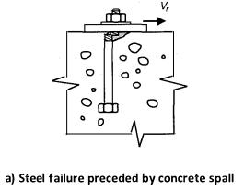
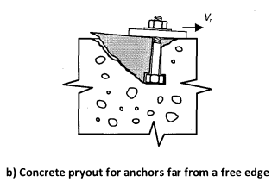
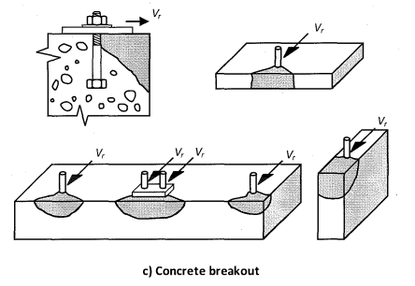
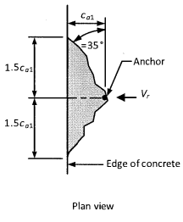
Anchor Shear Failure Modes, CSA A23.3-14

Slide 6
Cast in Place vs Post Installed Anchors
 | Cast in place (e.g. hooked, double nut, headed stud) | Post installed (e.g. screw, wedge, epoxy)
Installation | Must be set in new poured concrete with locations generally mapped out by gridlines and contractor | Existing concrete drilled on site in locations as needed
General application | For main column lines and braced frames of new buildings or new additions Strongest anchor type, good for high uplift | For small additions that are lightly loaded where precise cast in place locates are difficult e.g. canopies, ledgers for decks Or for connections to existing concrete
Anchor design considerations | No extra time cost with bigger anchors Generally better 3/4″ Ø anchor @12” instead of 1/2″ Ø @8” (similar capacity, less anchors) Difficult where precise location is critical (e.g. canopies) can compensate by oversizing wall plate and welding framing connection to wall plate on site | Much easier to drill (2) 1/2″Ø holes than one 3/4″ hole into concrete Generally better 1/2″ Ø anchor @8” instead of 3/4″ Ø @12” (similar capacity, smaller more frequent holes easier to drill)
Capacity considerations | Capacity affected by installation errors like short embedment, set with less concrete edge distance to compensate for misalignment, install conditions, etc | Capacity affected by dust, hitting rebar, closer to concr edge than specified, install conditions, etc

Slide 7
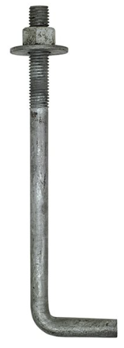
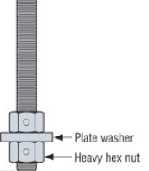
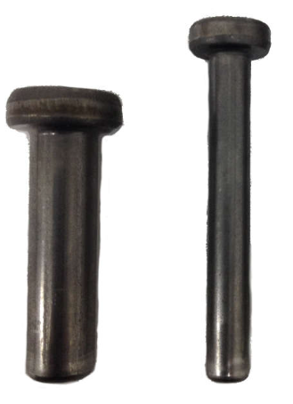
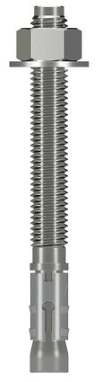
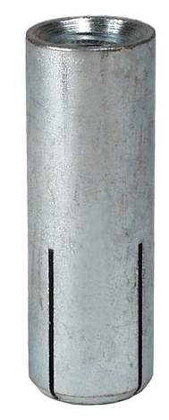
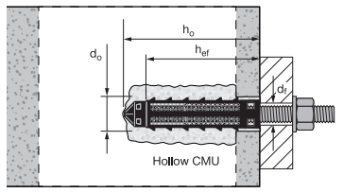
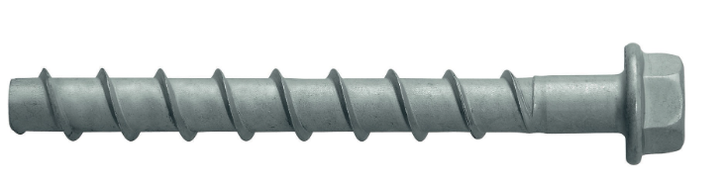
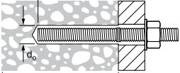
Anchor Types Overview
Cast in Place Anchors
Hooked | Double nut | Headed stud
Typically don’t specify brand since specify min 300W (steel gen notes) Typically cut as spec by struct/misc steel supplier |  | Typically Nelson studs
Post Installed Anchors
Mechanical
Screw | Wedge | Drop in
Simpson Titen HD Hilti KWIK HUS screw Tapcons | Simpson Strong-Bolt Hilti KWIK Bolt Wedge | Simpson DIA drop in Hilti HDV drop in
Adhesive
Epoxy Concrete | Epoxy CMU Block
Simpson SET-3G Hilti HY-200 | Simpson SET-XP Hilti HY-270 With screen if hollow CMU
NOTE: Simpson easier to find (at Home Depot) but typically lower capacity than Hilti

Slide 8
Cast in Place: Hooked & Double Nut Anchors
Hooked Anchors
Cast hooked anchor into concrete, once concrete cured, place grout pad and baseplate, then washer and nut baseplate to cast in anchor
Small gravity only columns, anchor bolts 3/4“ Ø or less
As per AISC design guide 1, hooked anchors can fail by straightening and pulling out of concrete through localized bearing failure of concrete above the hook
> 3/4” Ø, use double nutted anchors
Double Nutted Anchors
Same installation procedure as hooked
Uplift in column (e.g. braced frames), and/or anchor bolts >3/4″ Ø
Easier to cast in than hooked and has higher tension resistance
If no tension or shear to design for in anchor, still need at least 4 non-colinear anchors for construction/stability purposes, CSA S16, cl 25.2
May be able to place down to (2) anchors depending on support / geometry / particular column

Slide 9
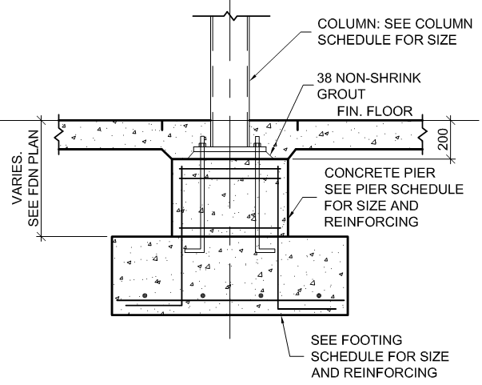
Cast in Place: Hooked & Double Nut Anchors Design
Both anchor rod types, easiest to find in ASTM F1554 Gr. A36
AISC Design Guide 01 suggests using ASTM F1554 Grade A36 anchor rods up to 2″Ø before switching to higher strength material grade, like Gr. A55
ASTM F1554 A36: Fy = 248 MPa, Fu = 400 to 552 MPa (CISC pg 4-159)
Check concrete shear and tension resistance
Generally if confined in concrete rebar (e.g. cage for pier), will just check if rebar has enough steel area and lap length to resist any uplift from anchor
Check anchor in combined shear and tension resistance
Tension: Cl 25.3.2.1, Shear: Cl 25.3.3.3, Combined: Cl 25.3.4
Hooked anchors calculate hook length based on ½*Tr (1/2 of steel tensile strength) for pullout strength Do not recommend hooked anchors if tension is high
Sample Hooked Anchors Supporting a Gravity Only Interior Column

Slide 10
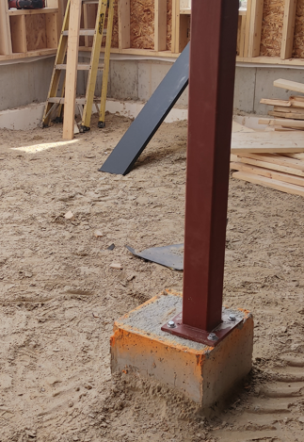
Cast in Place: Hooked & Double Nut Anchors Design cont…
Generally design anchor to max 70% utilization
Anchors are typically the most common areas for installation errors
Anchors are also very difficult to repair or fix if installed poorly or damaged
Good practice to design with lots of cushion in design to account for common installation errors
Common installation errors include
Set with less concrete edge distance to compensate for misalignment
Short embedment
Sample Anchors Misinstalled with Minimal Edge Distance

Slide 11
Cast in Place: Hooked & Double Nut Anchors Design cont…
Length of anchor rod should be checked case by case to ensure proper lap length with pier steel to be able to transfer full factored tension from anchor to rebar in pier
Tension resistance of pier rebar >= factored tension in anchor
Tension resist pier rebar = (rebar tension)*(lap L)/(develop L)
Minimum anchor lengths provided in typical capacity charts
Lap length
Sample Hooked Anchors Supporting a Gravity Only Interior Column

Slide 12
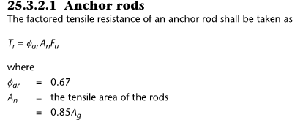
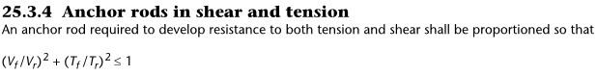
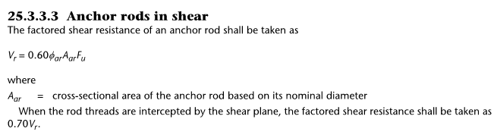
Cast in Place: Hooked & Double Nut Anchors Typical Resistances
Anchor Diameter | ASTM F1554 Grade | End Type | Recommend Min Length | Tr Hooked have Tr/2 | Vr Threads intercept shear plane
¾” | A36 | 4” hook | 2’ | Tr/2 = 7.3 kip = 32.4 kN | 6.1 kip = 27 kN
1” | A36 | Double nut | 2’6” | Tr = 25 kip = 111 kN | 10.6 kip = 47 kN
1 ¼” | A36 | Double nut | 3’ | Tr = 41 kip = 182 kN | 17.3 kip = 77 kN
1 ½” | A36 | Double nut | 3’6” | Tr = 58 kip = 258 kN | 24.4 kip = 108 kN
2” | A36 | Double nut | 4’ | Tr = 105 kip = 467 kN | 43.9 kip = 195 kN
ASTM F1554 A36: Fy = 248 Mpa, Fu = 400 Mpa (CISC pg 4-159)
Generally design anchor <70% utilization
Typical minimum sizes:
No uplift: Min 3/4″Ø, 24″ long + 4″ hook anchor
Uplift: Min 1″Ø, 36″ long + DBL nut anchor

Slide 13
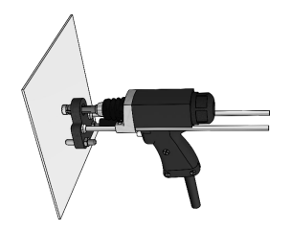
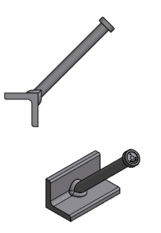
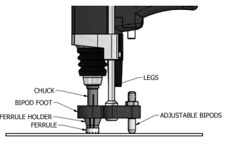
Cast in Place: Headed Stud
Headed Stud
Attach stud onto steel with a stud gun, then cast assembly into concrete
Can be designed as shear connection of steel to concrete for composite beams
Or for light use, like sprinkler / pipe / electrical hangers
Most commonly available studs CSA W59 Type B (Fu = 450 Mpa)
Nelson Stud Welding Gun Typical Use

Slide 14
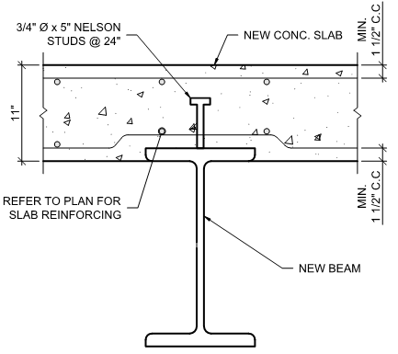
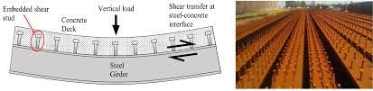
Cast in Place: Headed Stud Design
Composite Beam Design
Follow relevant checks in CSA S16-14 cl 17
Generally design anchor to max 70% utilization
Typical minimum size:
3/4“ Ø x 3” @24” Nelson studs (spacing cl 17.8)
Composite Beam Action with Headed Studs
Sample Composite Beam with Headed Studs

Slide 15
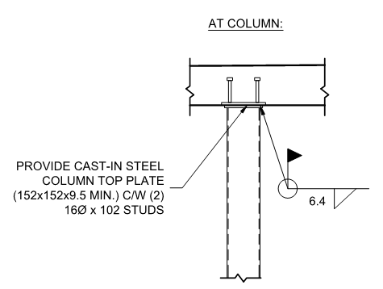
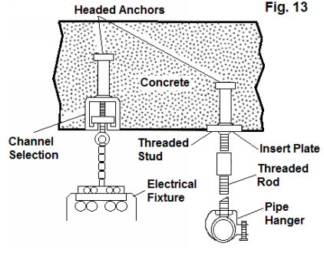
Cast in Place: Headed Stud Design cont…
Non Composite Anchor Design
Concrete pullout resistance of headed stud in CSA S16-14 cl 17.7.2
Generally design anchor to max 70% utilization
Typical minimum sizes:
Min 3/4“Ø x 3” Nelson studs @48” for integration of steel beam to concrete
Min (2) 5/8”Ø x 3” Nelson studs for lateral support of top of column
Min 1/2“Ø x 2” Nelson stud for sprinkler / light pipe / electrical hangers
Sample Lateral Support Top of Column with Headed Studs
Headed Studs for Hangers

Slide 16
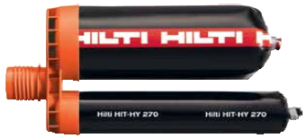
Post Installed Anchor Types
 | Mechanical Anchors | Adhesive Anchors
Withdrawal Resistance Behaviour | Mechanical interlock with concrete (friction, keying) | Adhesive compound between hole and anchor
Drilled Hole Cleaning Level | Medium effort | High effort
Time Until Full Anchor Resistance | Immediately after install | Proper conditions (temperature, moisture, etc) and time elapsed to cure adhesive
Types of Anchor | Screw, wedge, drop in Capacities specific to brand & model of anchor | Different adhesives for different anchoring mediums (e.g. concrete vs CMU block) Adhesive specific to brand, actual anchor bolt can be rebar, threaded rod, etc with corresponding capacities per adhesive brand
Samples

Slide 17
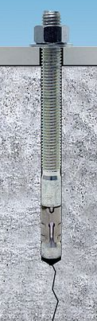
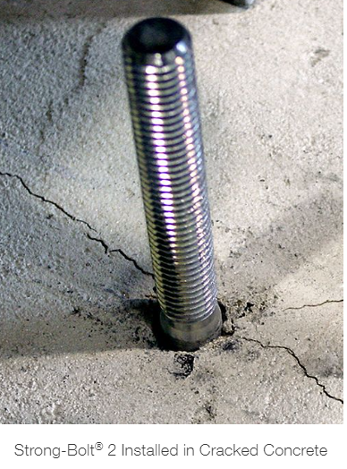
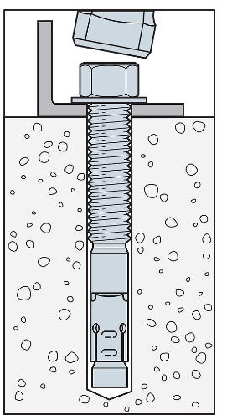
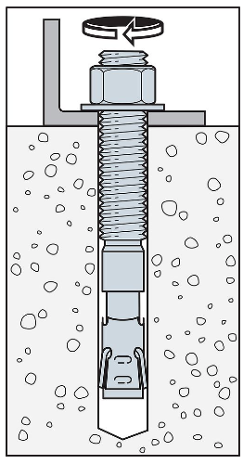
Post Installed: Mechanical Anchors
Screw Anchors (Simpson Titen HD or Hilti KWIK HUS screw)
Drill hole, blow clean with compressed air, screw anchor in
Less capacity than epoxy and cast in anchors, generally only to be used for stability
Wedge Anchors (Simpson Strong-Bolt or Hilti KWIK Bolt Wedge)
Drill hole, blow clean, hammer wedge anchor in, tighten nut to specified installation torque to flare out wedge mechanism torque controlled)
Wedge mechanism will crack surrounding concrete
DO NOT INSTALL CLOSE TO CONCRETE EDGE
Generally don’t advise using this in visible/ waterprone locations since concrete cracking will be apparent on surface
Don’t like suggesting wedge anchors in structural design unless gravity only interior column baseplate with cracking acceptable
Typical Installation Wedge Anchor
Cracked Concrete from Wedge Anchor

Slide 18
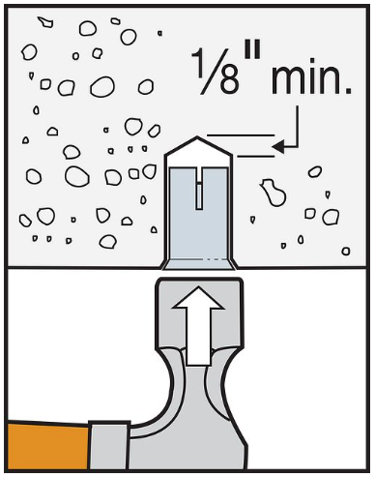
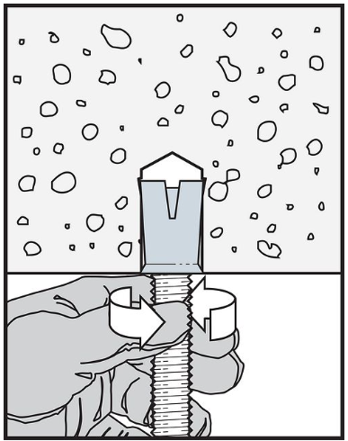
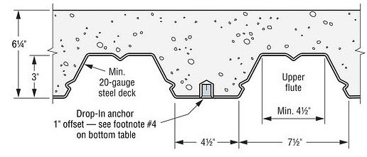
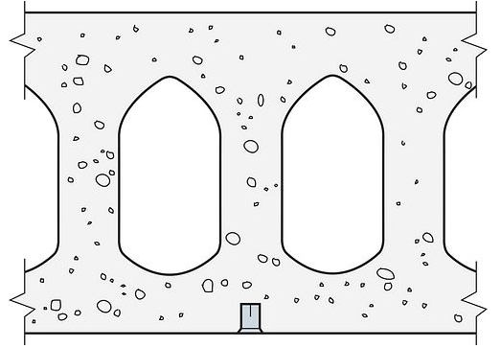
Post Installed: Mechanical Anchors cont…
Drop in Anchors (Simpson DIA drop in or Hilti HDV drop in)
Drill hole, blow clean with compr air, hammer then screw anchor in to engage wedge (displacement controlled)
Wedge mechanism will crack surrounding concrete
DO NOT INSTALL CLOSE TO CONCRETE EDGE
Generally don’t advise using this in visible/ waterprone locations since concrete cracking will be apparent on surface
Typically don’t like suggesting wedge anchors in structural design
Typically used to support pipe hangers from underside of concrete
Drop in Anchor Installation
Drop in Anchor in Concrete on Metal Deck
Drop in Anchor in Hollow Core

Slide 19
Post Installed: Mechanical Anchors Design
For structural purpose, only mechanical anchors typically like to suggest are screw anchors, even so, interior only, best for shear resistance and light tension
Typically design utilization <60%
Capacity affected by dust, hitting rebar, closer to concr edge than specified, install conditions, etc
Generally best practice assuming cracked concrete
Can get the anchor and concrete resistance by brand selection tables and reduction factors for spacing, edge distance, etc
Can also use brand anchor software
Simpson Strong-Tie Anchor Designer (computer program)
Hilti Profis (online software)
Must specify min edge distance and spacing, since post installed, could run into unforeseen interferences and tighter spacing (drastically reducing capacity)

Slide 20
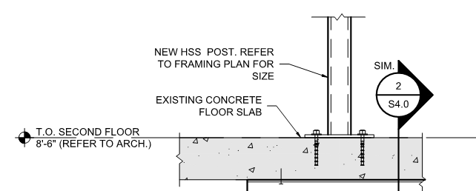
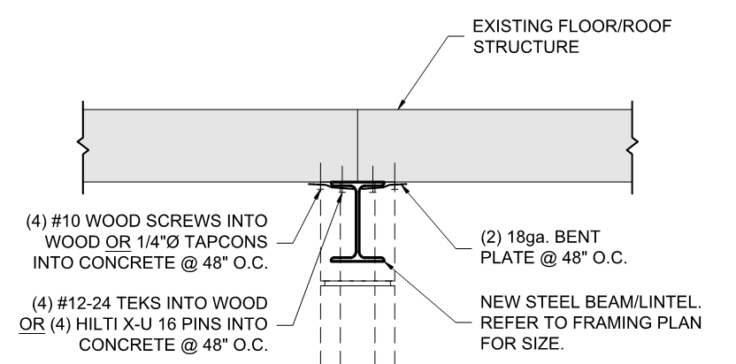
Post Installed: Mechanical Anchors Design cont…
Typical minimum sizes:
Gravity only small columns that are post installed
Min typically 5/8″ screw anchor 3″ embed (3″ into min 8” thick slab or foundation wall), min edge distance 4”
Restrict embed into concrete wall or slab to minimize risk of rebar conflict and tip breakthrough)
Attaching ledger for deck into concrete foundation wall
Min typically ½” Simpson Titen anchor 4” long @16”, min edge distance 4”
Laterally supporting top of steel beam
Min typically ¼”Ø tapcons @48”
Sample Screw Anchor for Lateral Support Top Flange Steel Beam
Sample Screw Anchor for Gravity Only Small Column

Slide 21
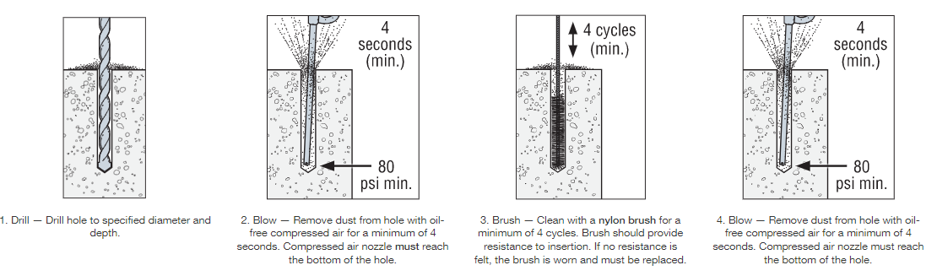
Post Installed: Adhesive Anchors
Epoxy Anchors into Concrete (Simpson SET-3G or Hilti HY-200)
Drill hole, blow clean, wire brush, blow clean, insert adhesive compound, install anchor, let cure
If dust is not blown out adequately, could reduce capacity by up to 60% (epoxy stick to dust, not hole walls)
Typically used for lightly loaded post installed applications like canopy
Simpson SET-3G is newer (and slightly stronger) version of SET-XP
Hilti HY-200 is newer version of HY-150 MAX
Typical Cleaning for Adhesive Anchors
https://www.strongtie.com/products/anchoring-systems/technical-notes/anchoring-adhesives/installation-instructions

Slide 22
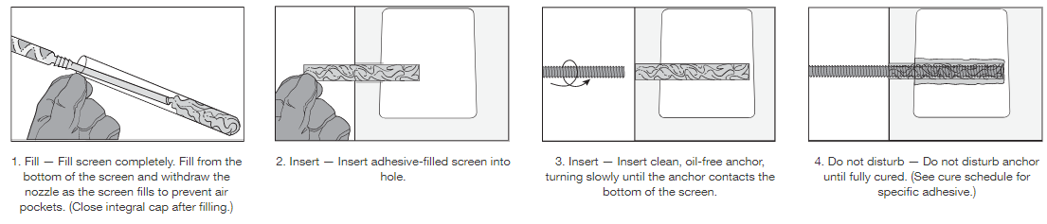
Post Installed: Adhesive Anchors cont…
Epoxy Anchors into CMU Block (Simpson SET-XP or Hilti HY-270, w/ screen if hollow)
Drill hole, blow clean, wire brush, blow clean, insert adhesive compound (into screen), install screen and/or anchor, let cure
The screen helps keep the epoxy from falling down away from anchor, cured epoxy around anchor & screen acts like a plug behind the wall of hollow CMU
Typically used for lightly loaded post installed applications like canopy
Simpson has published values for CMU with only SET-XP, not yet for newer SET-3G
Hilti HY-270 replaced HY-70
Typical Screen Installation for Adhesive Anchors in Hollow CMU Block
https://www.strongtie.com/products/anchoring-systems/technical-notes/anchoring-adhesives/installation-instructions

Slide 23
Post Installed: Adhesive Anchors Design
Typically design utilization <60%
Capacity affected by dust, hitting rebar, closer to concr edge than specified, install conditions, etc
Generally best practice assuming cracked concrete
Can get the anchor and concrete resistance by brand selection tables and reduction factors for spacing, edge distance, etc
Can also use brand anchor software for concrete (CMU must use tables)
Simpson Strong-Tie Anchor Designer (computer program)
Hilti Profis (online software)
Must specify min edge distance and spacing, since post installed, could run into unforeseen interferences and tighter spacing (drastically reducing capacity)
Must specify screen for anchor if hollow CMU block

Slide 24
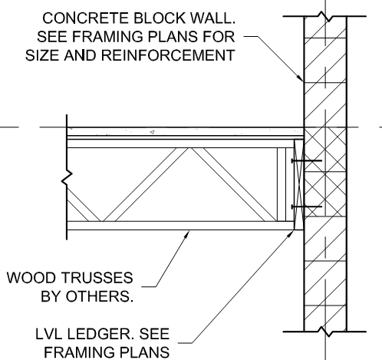
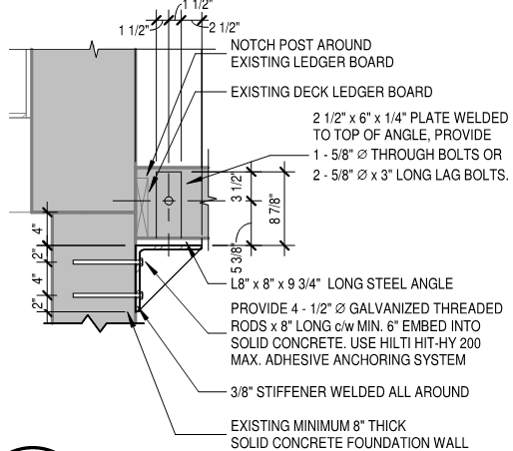
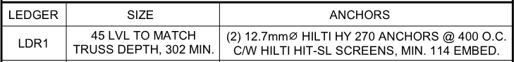
Post Installed: Adhesive Anchors Design cont…
Typical minimum sizes:
Min for small residential: 5/8″ Ø epoxy anchor 4″ embed, min 4” edge distance
Min for medium jobs: 3/4″ Ø epoxy anchor 6″ embed, min 4” edge distance
Restrict embed to 3 to 5″ into 8” thick slab or foundation wall to minimize risk of rebar conflict and tip breakthrough
Sample Concrete Adhesive Anchor for Deck Post Support
Sample Hollow CMU Block Adhesive Anchor for Floor Joist Support

Slide 25
Anchor Practical Considerations
Good practice to confine concrete around anchors to help increase the resistance of concrete failure modes like breakout
Good rule of thumb is anchor diameter => thickness of baseplate or steel it’s connecting if strength doesn’t govern anchor design
e.g. if a HSS6x6 gravity only column needs a 12″x12″x0.75″ baseplate (0.75” thickness needed to spread load), suggest (4) 0.75″ anchors
No matter anchor type, cannot by code anchor through brick veneer to support vertical loads, even if bolted through veneer into concrete wall or stud wall behind
Can switch joist/rafter span direction to avoid ledger through brick veneer
Or run beams at brick veneer supported by columns
Columns can end at fdns, or onto bracket fastened to concrete foundation wall below
Typical post-installed anchors, restrict embed to 3 to 5″ into 8” thick slab or wall
Restrict embed into concrete wall or slab to minimize risk of rebar conflict and tip breakthrough

Slide 26
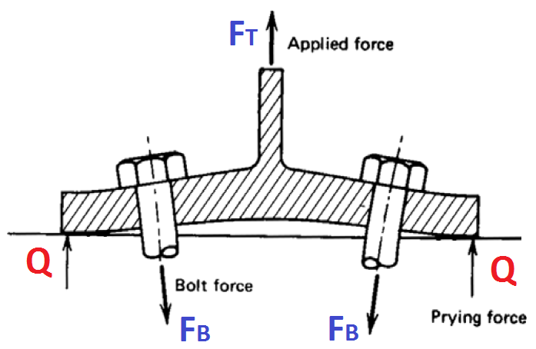
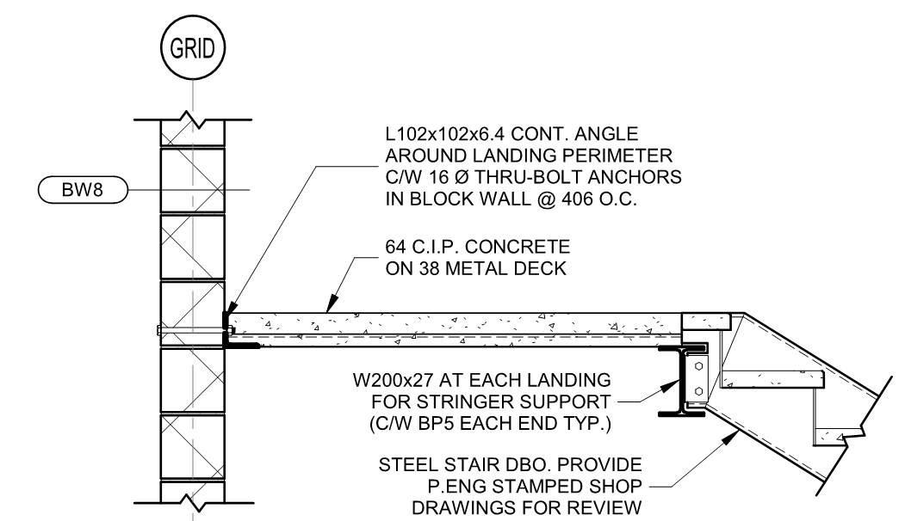
Anchor Practical Considerations cont…
If high tension onto plate with anchors, may need to consider prying force from flexible steel plate increasing tension resistance needed from anchor
The prying force occurs when a plate bearing against a surface (e.g. steel baseplate anchored to concrete) is pulled up in tension so much that the plate bends, forcing the tips to bear into the surface, adding further tension to the anchor bolts
If high tension resistance needed, through bolting (add plate at back to further increase breakout cone resistance) is a good option
Prying Force from Flexible Steel Plate
Sample Through Bolt in CMU Block Wall

Slide 27
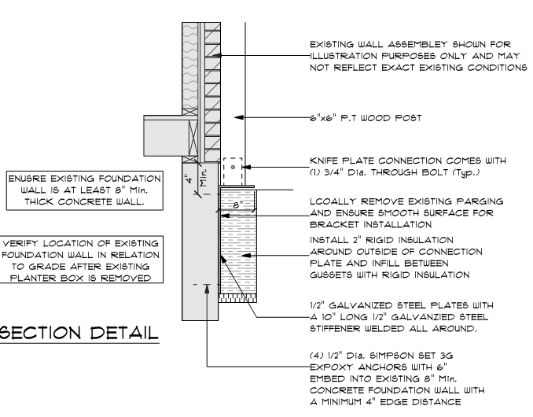
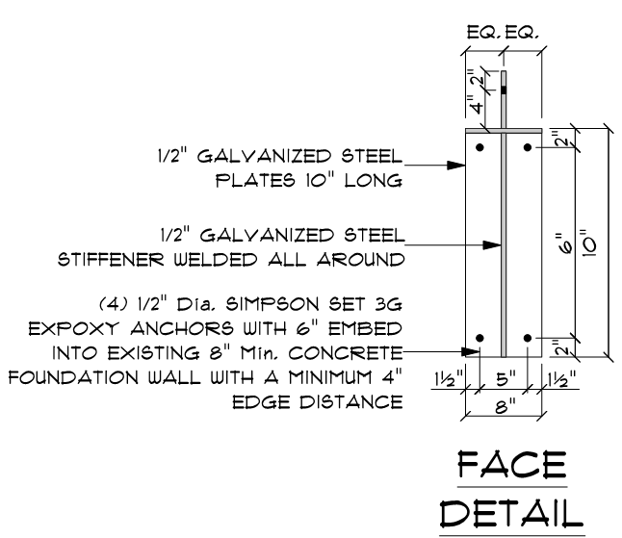
Anchor Practical Considerations cont…
Consider geometry and loading of scenario to find practical and effective anchor design and placement
Common scenario is the support for a deck cover post into the house concrete foundation wall
Example Post-Installed Anchors and Steel Angles Supporting Deck Cover Post

Slide 28
Anchor Practical Considerations cont…
Example: anchor and angle support design considerations
The longer the vertical leg of the angle, the more efficient (longer moment arm)
The top anchors are in tension, the bottom of the plate bears into concrete
Contractors may prefer to install the anchors low (more clearance and easier)
If too low, angle can bend and tension force into anchors will be higher (shorter moment arm)
Tension from anchor
Deck cover post
Deck cover post
Tension from anchor
Load from deck cover post
Load from deck cover post
Exaggerated deflected shape
Steel angle bearing into concrete (compr)
Moment arm
Steel angle bearing into concrete (compr)
Moment arm
House concr fdn wall
House concr fdn wall
Forces in Angle & Anchor Support
Not Ideal: Top Anchors Too Low

Slide 29
Anchor Practical Considerations cont…
Example: anchor and angle support design considerations
Provide min concrete edge distance 4”
Provide enough room to install the top anchors (min 1.5 to 2”)
Design top anchors for tension (taking couple moment)
Design bottom anchors for shear (from vertical post force)
Tension anchors
Shear anchors
Example Post-Installed Anchors and Steel Angles Supporting Deck Cover Post

Slide 30
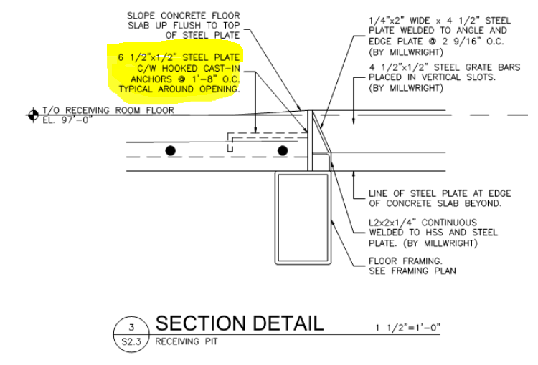
Anchor Practical Considerations cont…
Anchoring into side of concrete slab is special case
Not ideal since breakout cone so small
Can improve detail by ensuring cast in anchor hooked around slab rebar to reduce possibility of breaking out
Design anchors with low utilization <50% and make sure to input all edge distances since breakout cone is small
Simpson allows concrete breakout to be ignored if breakout is checked by hand and is resisted by rebar considering the specific detailing of the scenario
Sample Cast-In Anchor to Side Concrete Slab

Slide 31
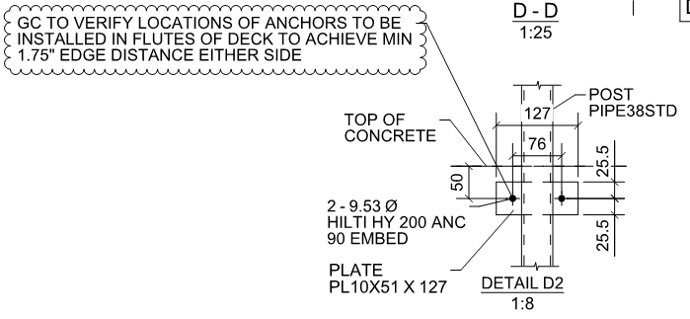
Anchor Practical Considerations cont…
Anchoring into side of concrete in metal deck is special case
Not ideal, would not recommend structurally, but in some scenarios with light loading (guards), can be done if anchoring parallel to flutes
Anchor design possible parallel to flutes if 2″ concrete on 1.5″ metal deck
The total concrete if in lower flute 3.5″ deep, gives just enough concrete edge distance 1.75″ either side for 3/8″ Hilti HY200 anchors
1.75″ concrete breakout in top, 1.75″ on bottom though steel deck will hold any concrete from breakout on bottom
Design anchors with very low utilization < 40 to 50% and make sure to input all edge distances since breakout cone is small and unreliable detail
Make sure to include note “GC to verify locations of anchors to be installed in flutes of deck to achieve min 1.75″ edge distance either side”
Sample Post-Installed Adhesive Anchor to Side Concrete on Metal Deck

Slide 32
Anchor & Bolt Hole Typical Dimensions
Holes sizes for different bolts given in CISC Handbook
Bolt Ø |  | Standard hole Ø specified (pg 3-113) |  | Max hole Ø for baseplates (pg 4-158)
½” | 13 mm | 9/16” | 14 mm | -
5/8” | 16 mm | 11/16” | 17 mm | -
¾” | 19 mm | 7/8” | 22 mm | 1 5/16” | 33 mm
7/8” | 22 mm | 15/16” | 24 mm | 1 9/16” | 40 mm
1” | 25 mm | 1 1/16” | 27 mm | 1 13/16” | 46 mm
1 ¼” | 31 mm | 1 3/16” | 30 mm | 2” | 52 mm
1 ½” | 38 mm | 1 5/16” | 33 mm | 2 5/16” | 59 mm
1 ¾” | 45 mm | 1 9/16” | 40 mm | 2 6/8” | 70 mm
2” | 51 mm | - |  | 3 ¼” | 83 mm
2 ½” | 64 mm | - |  | 3 ¾” | 95 mm

Slide 33
Anchor & Bolt Hole Minimum Distances
Bolt edge distance for different bolts given in CISC Handbook
Bolt pitch (spacing) CL to CL of bolts >=2.7 * (bolt Ø), CSA S16-14, cl 22.3.1
Bolt Ø |  | Edge distance from CL bolt (sheared edge) (Table 6, pg 1-165) |  | Edge distance from CL bolt (rolled, sawn, gas/plasma/water/laser cut edges) (Table 6, pg 1-165) |  | Installation clearance from CL bolt (pg 6-174)
5/8” | 16 mm | 1 1/16” | 28 mm | 7/8” | 22 mm | 1” | 25.4 mm
¾” | 19 mm | 1 ¼” | 32 mm | 1” | 25 mm | 1 ¼” | 31.8 mm
7/8” | 22 mm | 1 ½” | 38 mm | 1 1/16” | 28 mm | 1 3/8” | 34.9 mm
1” | 25 mm | 1 ¾” | 44 mm | 1 ¼” | 32 mm | 1 7/16” | 36.5 mm
1 1/8” | 29 mm | 2” | 51 mm | 1 ½” | 38 mm | 1 9/16” | 39.7 mm
1 ¼” | 31 mm | 2 ¼” | 57 mm | 1 5/8” | 41 mm | 1 11/16” | 42.9 mm
1 3/8” | 35 mm | 1.75*(bolt Ø) |  | 1.25*(bolt Ø) |  | 1 ¾” | 44.5 mm
1 ½” | 38 mm | 1.75*(bolt Ø) |  | 1.25*(bolt Ø) |  | 1 7/8” | 47.6 mm
> 1 ½” | > 38 mm | 1.75*(bolt Ø) |  | 1.25*(bolt Ø) |  | -

Slide 34

Typical Anchor Baseplate Pier Sizes
<1”Ø anchors need 1.5” installation clearance
Baseplates are typically rolled and gas cut, so <1”Ø anchor needs 1.5” edge distance
Grout on top of pier and under baseplate to ensure level and even bearing, 1.5” thick and 1.5” wider from baseplate edge
Pier should have 1.5” extra room for grout
This means for typical anchor <1”Ø:
Baseplate width = (col width) + 6”
1.5” either side of each anchor
Pier width = (basepl width) + 6”
1.5 either side for grout + 1.5 either side for pier
All spacing between red lines min 1.5”
Sample Column Baseplate Pier Size

Slide 35
2. Concrete Reinforcement
Typical concrete rebar
Concrete rebar types
Code requirements & recommendations
Key notes on reinforcement requirements
Reinforcement details good practices

Slide 36

Typical Concrete Rebar
Typically rebar is CSA G30.18-M92 grade 400R (Fy = 400 Mpa, regular)
Rebar strengths are 300 / 400 / 500 Mpa
Can be regular “R” rebar, or weldable “W” rebar
Typical max lengths of rebar
10M, length generally <12m = 40’
15M and larger, length generally <18m = 60’
Generally for ease on site placing bars, max length 9m = 30’
Where rebar is needed longer, bars typically lap spliced
Generally, 30M rebar are unwieldy on site, better practice to use more 25M instead
Typical Rebar Markings

Slide 37
Concrete Rebar Types
Standard reinforcing steel forms a passive thin oxide layer due to concrete providing high pH environment, providing some corrosion resistance
Ductile failure mode, typical design procedure of reinforced concrete
Tight rust/scale acceptable and increases bond with concrete (RSIC manual of standard practice)
There are other bar types that offer more corrosion resistance
They are typically more expensive, and some must be designed with different design principles
Ensure compatible chairs, spacers and ties are used for different bar types
e.g. galvanized wire for galvanized rebar or plastic ties for epoxy coated steel

Slide 38
Concrete Rebar Types cont…
Rebar Type | Corrosion Resistance | Notes | Design Method
Galvanized steel CSA G164-M92 & ASTM A767M | High resistance Has protective zinc coating | More expensive per bar than standard steel | Same design method and strength as standard steel
Stainless steel ASTM A955M & CSA G30.18 | Very high if no contact with incompatible metal Metal composition does not corrode in concrete / air | More expensive per bar than galvanized steel Avoid contamination from standard steel (galvanic corrosion) | Similar design method as standard steel with a lower Fy
Epoxy-coated steel ASTM A755 D3963 TYPICALLY AVOID – see notes | High resistance if undamaged Standard steel bar coated with epoxy | Nicks in bars coating provides concentrated corrosion site UV reduces coating effectiveness In event of fire, heat will often coating and reduce bond (CSA A23.3,m cl 3.1.1) | Similar design method and strength as standard steel
Fibre-reinforced polymer (FRP) CSA S806 | No corrosion | Around same price per bar as standard steel, but overall typically more expensive (need more FRP bars than steel in design) | Different design method to standard steel (brittle failure)

Slide 39
Code Requirements & Recommendations
Reinforcement requirements: CSA A23.1 & CSA A23.3
Standard practice recommendations (not code): RSIC manual of standard practice
If concrete structural component is allowed to fall under plain unreinforced concrete (CSA A23.3, cl 22.1.1), then do not have to meet reinforcement spacing and area in other parts of code
Often will place reinforcement for some plain concrete components to reduce cracking and increase reliability for accidental/lateral loads that may induce bending/tension in component

Slide 40

Key Notes on Reinforcement Requirements
Column longitudinal bar (CSA A23.3, cl 10.9.1, 10.9.2 & 10.10.5)
Min area reinf = 0.01*Ag
Reduced resistance min = 0.005*Ag
Reduce columns resistance by 0.5*(1+reinfRatio/0.01)
Max area reinf = 0.08*Ag
Typical placing max = 0.04*Ag
Walls & slab bars (CSA A23.3, cl 7.8.1 & 14.1.8.6)
min area of horizontal steel = 0.002*Ag
This is total area, can consider both layers of reinforcement
Area of longitudinal reinf:
Min 0.01*Ag (reduced strength 0.005*Ag)
Max 0.08*Ag (typical max 0.04*Ag)
Clause 10.9.1, 10.9.2 & 10.10.5, Sample Column Longitudinal Bar Ratio

Slide 41

Reinforcement Details Good Practice
Good practice to tie rebar into other crossing rebar so that if tension tries to pull rebar out, it will be tied in by crossing rebar
e.g. in cantilever retaining wall, have hooked dowel run underneath footing mat, so when wall goes into bending and dowel tries to pull out in tension, it engages bottom mat, increasing resistance by not only relying on concrete resistance
Sample Reinforcement Hooking Below Mat

Slide 42



Reinforcement Details Good Practice cont…
Specify cover for members in bending, especially walls in bending
Easy to miss retaining wall reinforcement location on site since typical wall reinforcement is centered
Make sure bars are in the correct location (tension face) with adequate dowels to transfer shear
No tension face, centered rebar
Tension face with Rebar
Tension face with rebar
Wall Deflected Shape
Soil pressure
Soil pressure
Wall Deflected Shape
Soil pressure
Cantilever Retaining Wall
Simply Supported Retaining Wall
Typical Non-Retaining Wall

Slide 43

Reinforcement Details Good Practice cont…
Dowels match worst case rebar with full development length for continuity of tension resistance across joint
Otherwise, check if dowel detail has enough resistance to transfer actual force across joint (shear / tension)
E.g. dowelling top of wall to slab to bottom of wall
Dowel length to be full tension development length on either side of slab, matching worst case 15M@200
Dowel length = (tension develop length 430mm = 17″) + (slab thickness 200mm = 8″) + (tension develop length 430mm = 17″) = 42″ (Round up to 1520mm = 5′ long)
Sample Column Baseplate Pier Size

Slide 44

Reinforcement Details Good Practice cont…
One way slab typically add top steel as full mat, and additional steel only where needed for negative bending zones (over supports)
Having top steel as full mat is typically easier to construct and can build dowels etc off cage easier
Check (length of additional steel) > (development length needed for tension in top steel)
Development length of negative bending top steel to extend minimum:
Min 0.3*span beyond continuous support face (CSA A23.3, cl 12.11.1)
Min 0.25*span beyond end support face (CSA A23.3, cl 12.11.1)
These are roughly extending from max negative moment to 0 moment
Min One Way Slab Top Steel Reinforcement Length (RSIC)

Slide 45

Reinforcement Details Good Practice cont…
Consider interaction of rebar with other potential collisions and take into account for in design and rebar placement / cover
E.g. concrete beams intersecting, must specify and account for dropped reinforcement in one beam to make room for overlapping steel
Beam Intersection
Beam with Dropped Reinf
Beam with Typical Placement of Reinf
Beam with Dropped Reinf
Beam with Typical Placement of Reinf
Intersecting Concrete Beams with Dropped Reinforcement

Slide 46


Reinforcement Details Good Practice cont…
CSA A23.3, clause 13.10.6 requirements to have bottom bars able to transfer shear from slab to column support
Typically not called out each column, but with a detail, easy to miss
Make sure the bottom bars are provided for slabs over columns to resist against punching shear
Reinforcement for Slab Column Connection (CAC Handbook N13.10.6)
Typical Detail for Slab Column Connection

Slide 47

Reinforcement Details Good Practice cont…
Structurally, best beam stirrup detail is closed
Closed ties defined in CSA A23.3, cl 7.6.6.3
Closed stirrup provides resistance to beam torsion
Code requires the stirrups to be closed or spiral if stress reversal or torsion in beam (CSA A23.3, cl 7.6.6.2)
Assembly for closed stirrup around longitudinal bars is preassemble entire cage and drop into form
Sometimes this cannot be done
E.g. ICF wall concrete lintel with stirrups
E.g. longitudinal beam interlaced through closely fitting column bars or other intersecting beams
Stirrup as Closed Tie

Slide 48


Reinforcement Details Good Practice cont…
If cannot drop cage into place, best practice to detail two-piece stirrup that’s not closed (RSIC chapter 5) or equivalent 1 legged stirrup
Otherwise on site, stirrups may be placed in closed form, opened to fit longitudinal bars in, then closed again (fatiguing rebar, as noted in RSIC)
CSA A23.3, cl 7.6.6.2, cannot use non-closed stirrups if need torsion resistance
Two-Piece Stirrup NOT CLOSED
One-Legged Stirrup NOT CLOSED

Slide 49


Reinforcement Details Good Practice cont…
Typically specify circular ties, not spiral reinforcement for ease of site placement
If spiral reinforcement is used in columns, need min 6 vertical bars to tie to, circular only 4 (CSA A23.3, cl 10.9.3)
Spiral reinforcement has more ductile behaviour than ties and desirable for seismic heavy applications
Circular Ties
Spiral Ties

Slide 50
Thank you!

Slide 51

Spacing & Area of Reinforcement: General
General
CSA A23.1, cl 6.6.5
rebar min clear dist = max (1.4*bar dia, 1.4*max agg=1.4*20mm, 30mm)
Practically speaking, parallel rebar should be >=4″ oc to give room for lapping
This is to allow enough space for concrete to flow between bars and fill spaces
Clause 6.6.5, min rebar spacing

Slide 52


Spacing & Area of Reinforcement: Compress Member
Compression member
CSA A23.3, cl 7.4.1.3
Max clear distance longitudinal bars = 500mm = 20”
To have adequate confinement of central concrete column
CSA A23.3, cl 7.6.5.2
max tie space = min(16*Ø reinfbar, 48*Ø ties, smallest dim of compr member, 300mm if have bundled bars)
To shorten unsupported buckling distance of longitudinal bars
CSA A23.3, cl 7.6.5.5
Ties at every corner and alternate longitudinal bars if <150mm spacing
Ties to restrain longitudinal bars from outwards buckling
Max tie space = min(16*Ø reinfbar, 48*Ø ties, smallest dim of member, 300mm if bundled bars)
Max clear dist = 500mm = 20”
Clause 7.4.1.3, Sample Column Max Rebar Spacing
Clause 7.6.5.2, Column Max Tie Spacing
Clause 7.6.5.5, Column Ties

Slide 53
Spacing & Area of Reinforcement Columns
Columns
CSA A23.3, cl 10.9.1
min area reinf = 0.01*Ag
CSA A23.3, cl 10.9.2
max area reinf = 0.08*Ag
Although more than 4% can be difficult to place
CSA A23.3, cl 10.10.5
Area reinf ratio between 0.005 and 0.01 acceptable if reduce resistance by 0.5*(1+reinfRatio/0.01)
CSA A23.3, cl 7.6.5.8
If anchors at top of column
Anchors must be enclosed by lateral reinf surrounding min 4 vertical col bars
Lateral reinf must be distributed within 125mm = 5” from top of col with min (2) 10M bars
Confine concrete around anchors to increase breakout resistance
Area of longitudinal reinf:
Min 0.01*Ag (full strength col)
Max 0.08*Ag (even 4% hard to place)
Min 0.005*Ag (reduced strength)
Clause 10.9.1, 10.9.2 & 10.10.5, Sample Column Longitudinal Bar Ratio
Min (2) 10M within top 5” pier
Clause 7.6.5.8, Min Reinf Top of Column or Pier for Anchors

Slide 54
Spacing & Area of Reinforcement Flexural Members
Flexural members
CSA A23.3, cl 10.5.1.1
min reinf area so that Mr >= 1.2*Mcr
Prevent brittle failure at first cracking with post-cracking strength
CSA A23.3, cl 10.5.1.2
In lieu of 10.5.1.1, min area steel for Mr > 1.33*Mf
CSA A23.3, cl 10.6.1
Min tension steel so Z limit met
Different requirements for different crack control tolerances

Slide 55

Spacing & Area of Reinforcement Beams
Beams
CSA A23.3, cl 7.6.6.1
Beam compr reinf enclosed by ties meeting compr member tie requirements
To laterally support compress bars from outwards buckling
CSA A23.3, cl 10.5.1.2
In lieu of 10.5.1.1, beams min area steel = 0.2*sqrt(f’c)*(width tens zone)*h/fy
CSA A23.3, cl 10.6.2
Beams overall depth = h > 750mm=30” shall have uniformly spaced skin reinforcement
Rebar close to principal reinf over distance = 0.5*h-2*(h-d)
Area of skin rebar = rho sk * Acs
rho sk interior = 0.008, exterior = 0.01
Max spacing skin reinf = 200mm = 8”
Compression reinf enclosed by ties meeting compress member reinf requirements
Clause 7.6.6.1, Sample Beam Compression Reinforcement
Skin reinf with area, spacing, and distance meeting clause 10.6.2
Clause 10.6.2, Sample Deep Beam Skin Reinforcement

Slide 56

Spacing & Area of Reinforcement Walls
Walls
CSA A23.3, cl 7.4.1.2 & 14.1.8.4
max clear dist principal reinf = min(3*thickness, 500mm = 20″)
CSA A23.3, cl 14.1.8.2
max Ø of distributed vert and horiz reinf = Wall thickness / 10
CSA A23.3, cl 14.1.8.3
walls >210mm = 8.25” thick and not retaining, reinf EW two layers placed within t/3 from each side of wall
CSA A23.3, cl 14.1.8.6
min area of horizontal steel = 0.002*Ag
This is total area, can consider both layers of reinforcement
Principal reinf (wall spans vertically) max clear dist = min( 3*thickness, 500mm = 20″)
max Ø of distributed vert and horiz reinf = Wall thick / 10
Wall not retaining but < 8.25” thick (only one layer reinf needed)
min area of horizontal steel = 0.002*Ag
Clause 7.4.1.2, 14.1.8.2, 14.1.8. & 14.1.8.6, Sample Wall Reinforcement

Slide 57

Spacing & Area of Reinforcement Slabs & footings
Slabs & footings
CSA A23.3, cl 7.8.1
min steel area each way = 0.002*Ag
For crack control by shrinkage and temp
This is total area, can consider both layers of reinforcement
CSA A23.3, cl 7.8.3
Max spacing of reinf = min( 5*slab thickness, 500mm = 20”)
CSA A23.3, cl 7.4.1.2
ONE WAY SLABS: max clear dist principal reinf = min(3*thickness, 500mm = 20″)
min steel area EW = 0.002*Ag
Max spacing = min(5*slab thick, 500mm = 20”)
ONE WAY SLAB: max clear dist principal reinf = min(3*thickness, 500mm = 20″)
Clause 7.8.1, 7.8.3 & 7.4.1.2, Sample Slab Reinforcement

